Slide 1
Visualization of geospatial data for drought, vegetation, temperature, and wildfire
CS226 Big Data Management Fall 2022
Group: Data VIZards
Name: Mrunali Lachake
Name: Kaushik Daiv
Name: Shivanshu Gupta
Name: Dhananjay Gavade

Slide 2
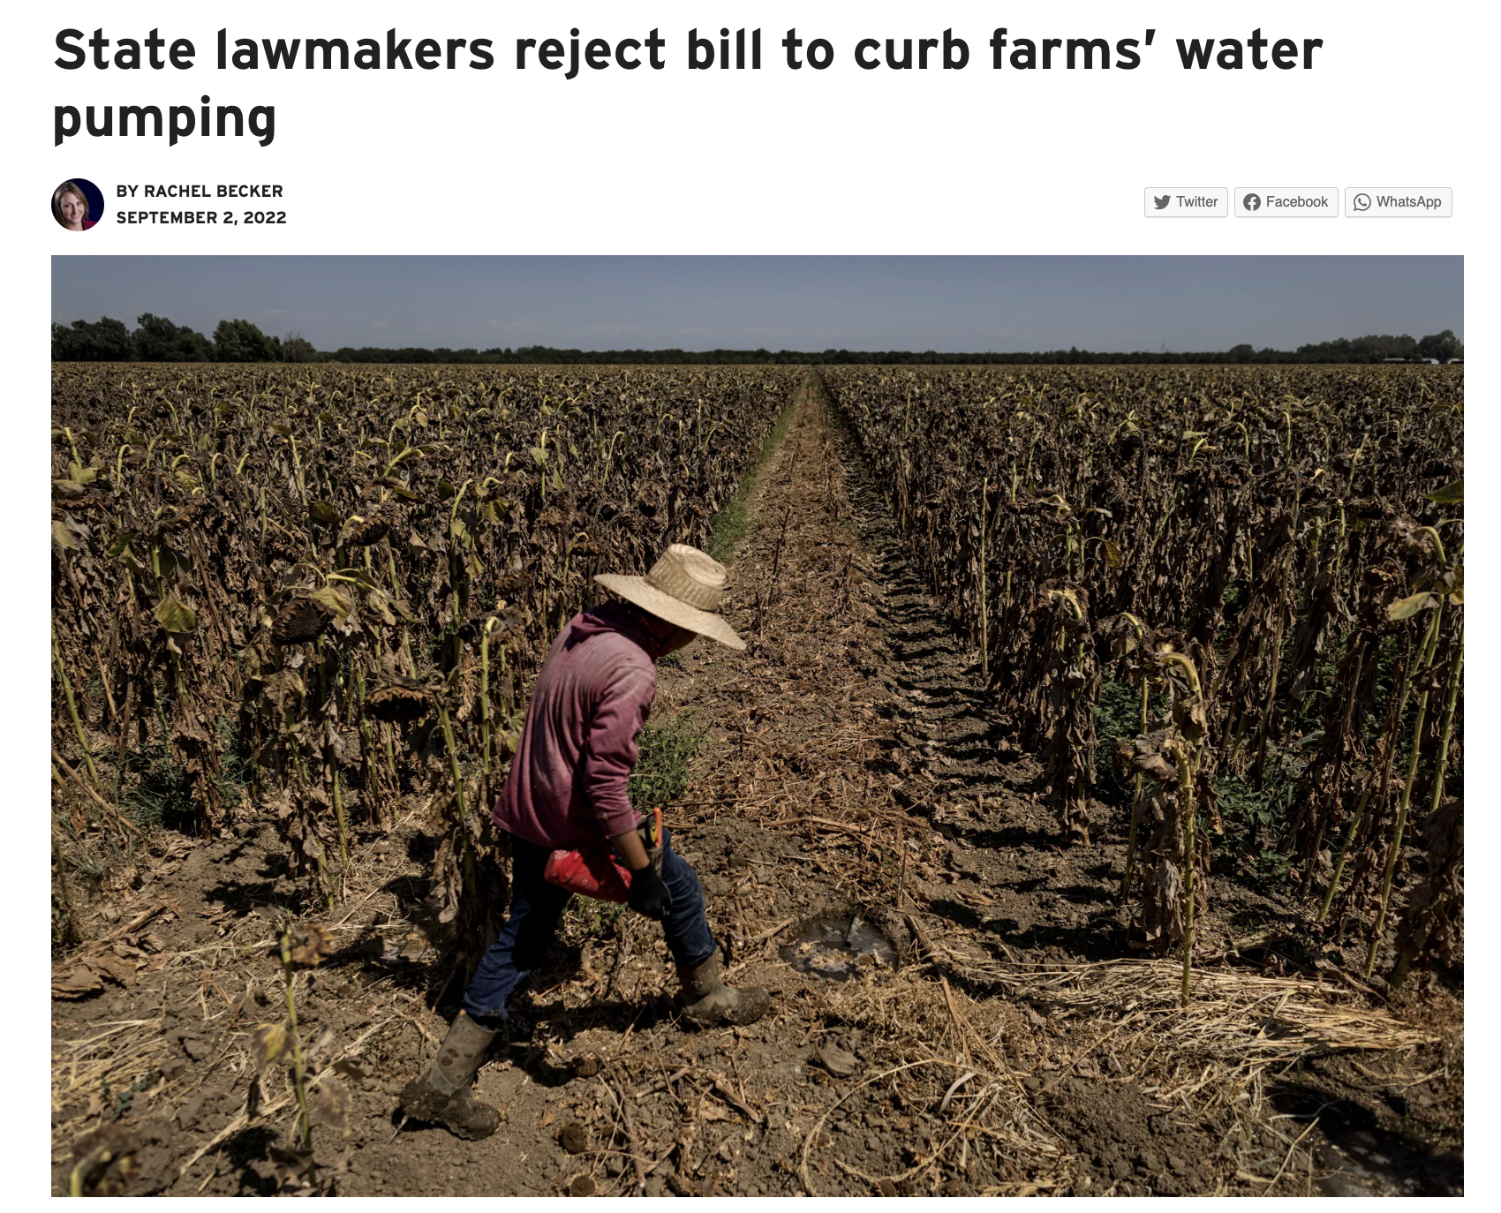
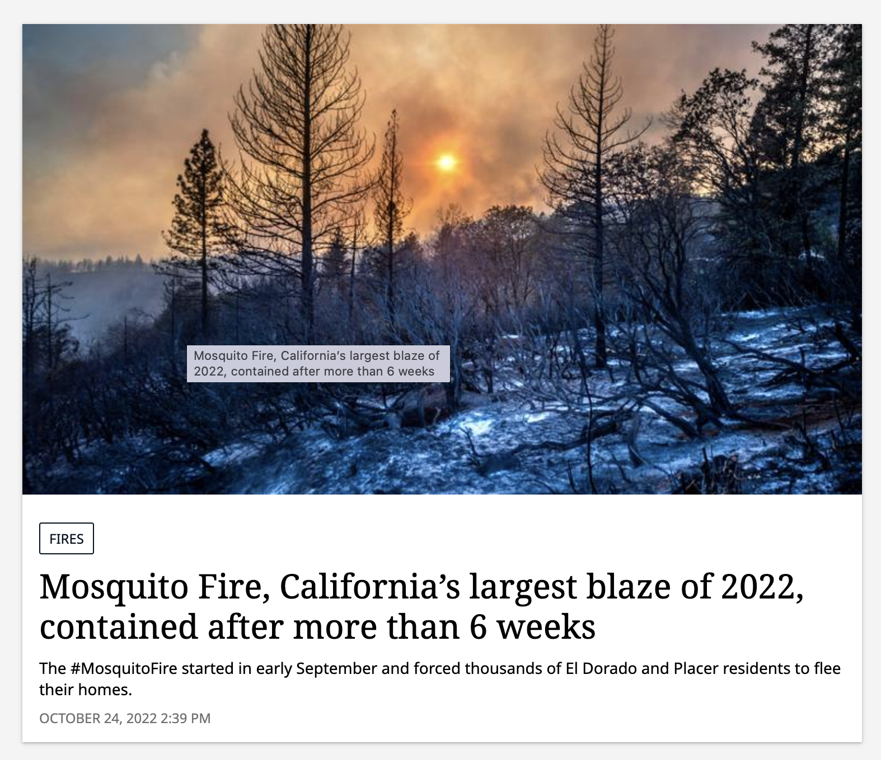
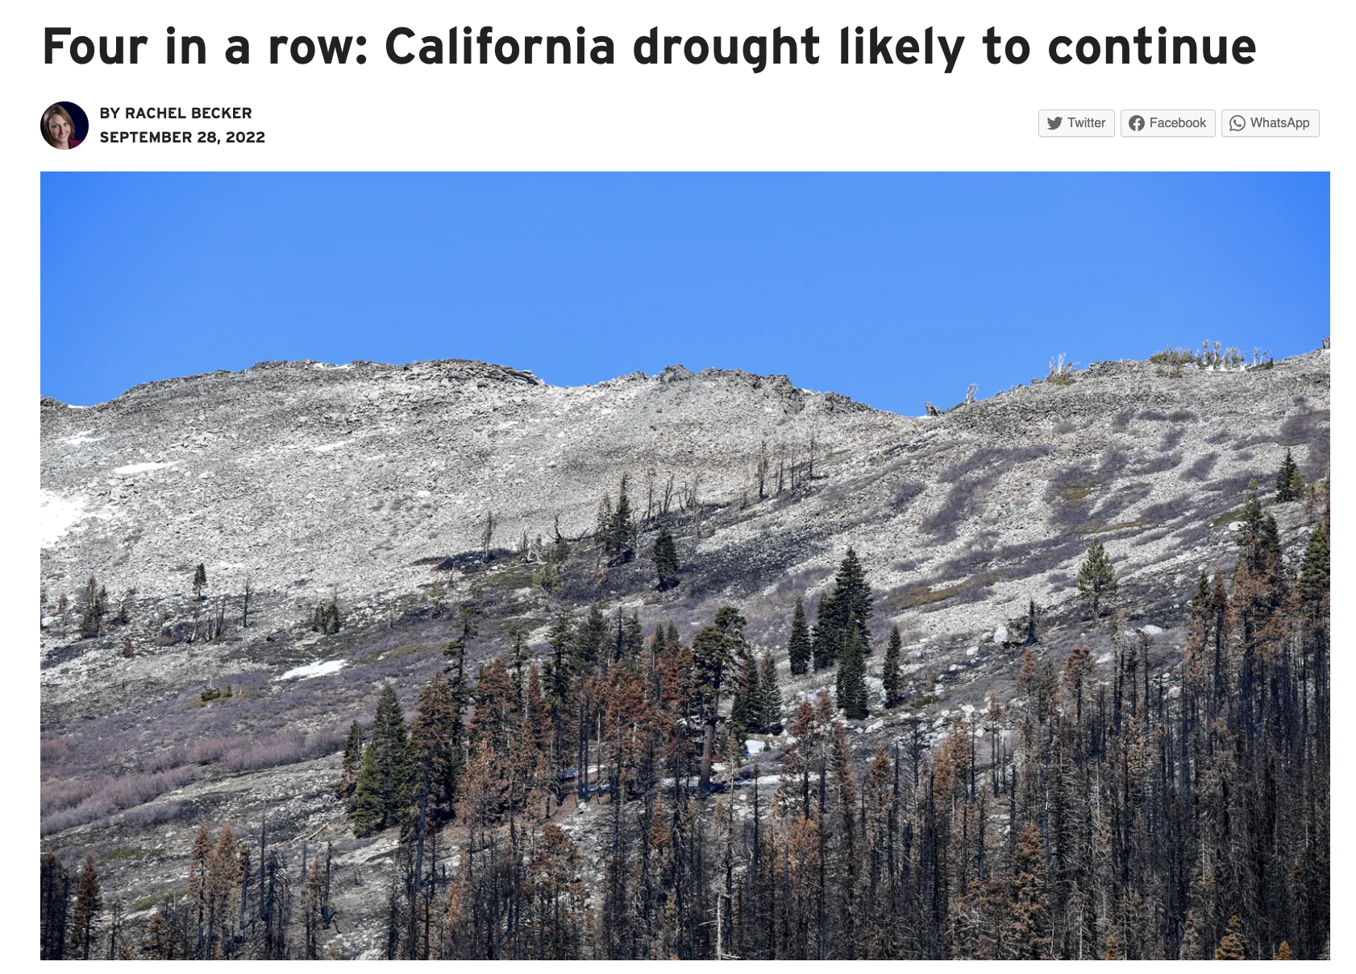
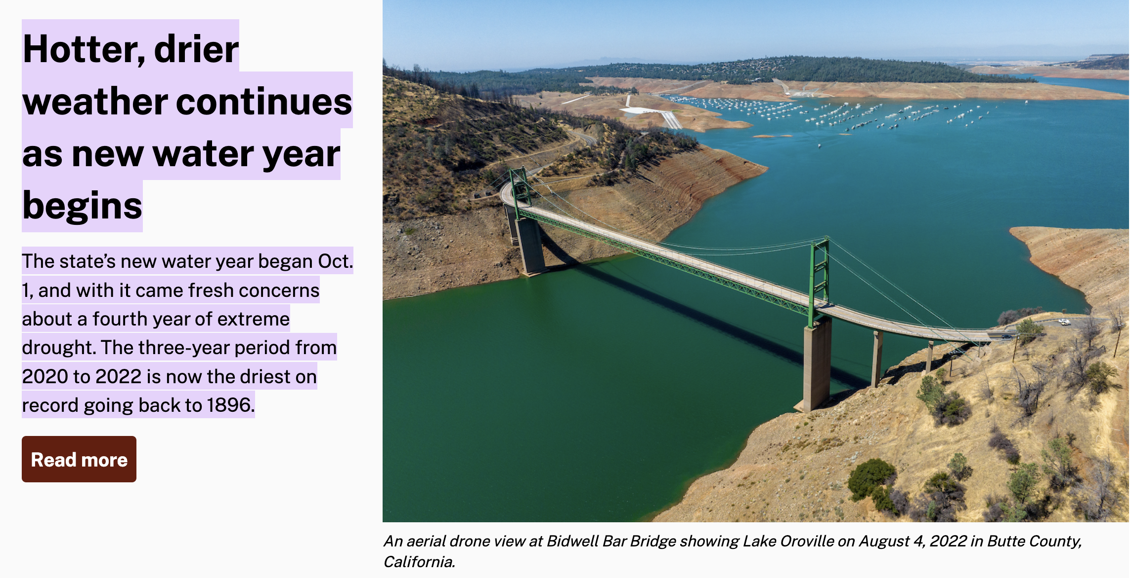
Drought and Wildfire conditions in California

Slide 3
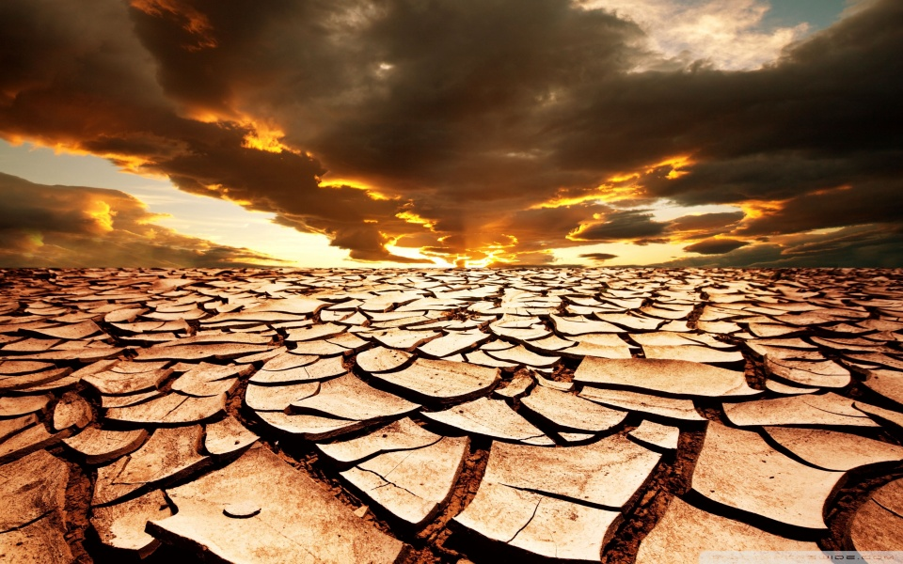
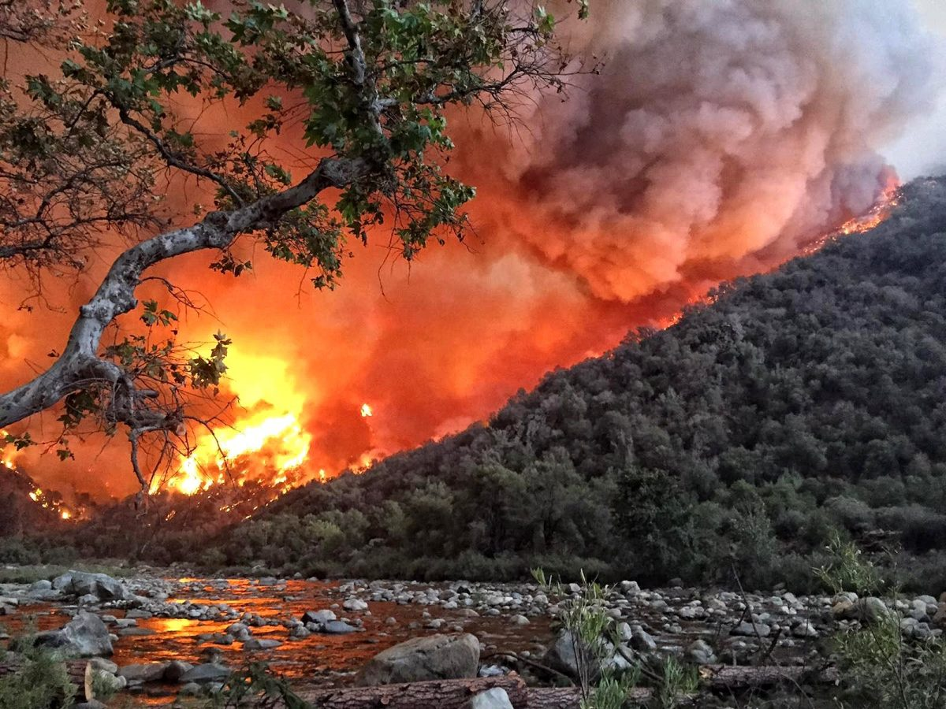
Drought combined with warming temperature can result in increased evaporative demand, and dry soil which results in increased potential of large wildfires

Slide 4
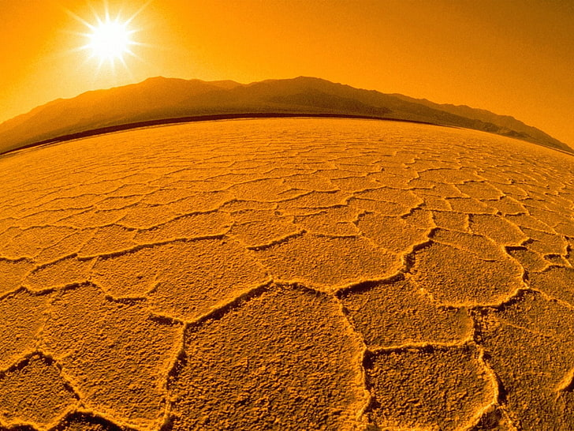

How does rise in temperature cause drought?
Can temperature rise and drought affect vegetation?
Can there be any correlation between these factors?

Slide 5


Datasets
1. Drought Dataset
2. Wildfire Dataset
3. Temperature Dataset
4. Vegetation Dataset

Slide 6

Drought Data
Source - United States Geological Survey
Two main factors:
Streamflow
Groundwater level
Features include site id, name, lat/long, amount of water.
This Photo by Unknown author is licensed under CC BY-ND.

Slide 7
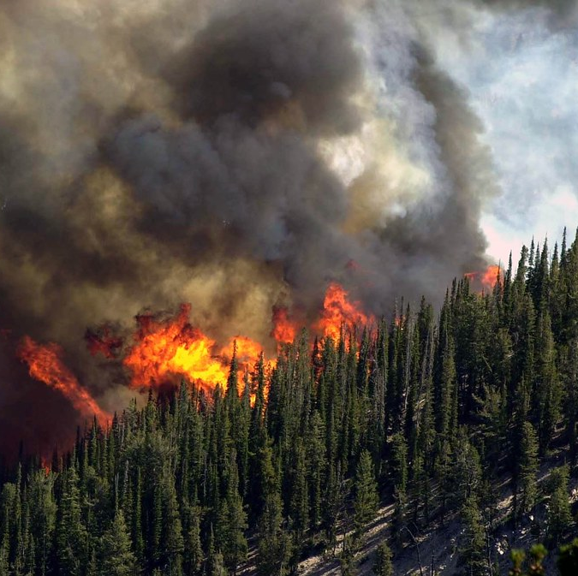
Wildfire Data
Source – WildfireDB
Data format - csv
Features include -min/max temperature, fire radiative power(FRP), and fire acquisition time
This Photo by Unknown author is licensed under CC BY.

Slide 8
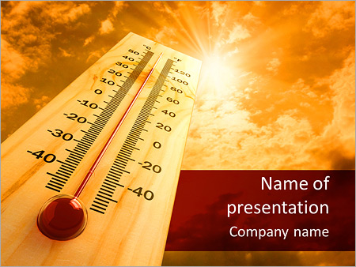
Temperature Data
Source – Kaggle
Data format - csv
Dataset includes attributes like: Lat/long, city, date, avg temperature

Slide 9

Vegetation Data
Source - United States Geological Survey
Tiff formatted satellite images
1236 satellite photos

Slide 10
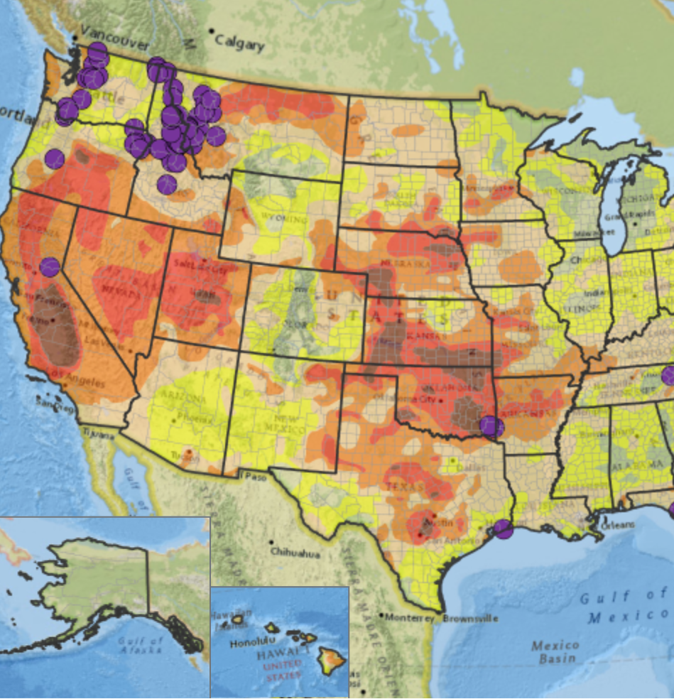
Outcome
Geospatial data used for the following:
Weather
Vegetation
Wild fire
Level of drought
Data gathered over a 20-year period
Users will be able to choose multiple parameters while viewing satellite data for all 4 categories.

Slide 11



Proposed Architecture
MAPREDUCE
Input
Output
Visualization
Datasets in CSV

Slide 12

Evaluation Plan
Evaluation will be done in two parts
Evaluate correlation between datasets: Spearman
Evaluate accuracy of spatial data : K-Means

Slide 13
Plan
Environment Setup
Storage setup and Data loading
Preprocess Datasets
Create visualization report
Design and develop Visualization
Transform data and design pipeline
Prepare Final Presentation and demo

Slide 14

Thank You

